Slide 1
Chapter 2
Intelligent Agents
By: Arjun Singh Saud
Lecturer, CDCSIT, TU

Slide 2

Intelligent Agents
An agent is anything that can perceive its environment through sensors and acts upon that environment through effectors.
Sensors
Environment
Actuators

Slide 3
Intelligent Agents
Example: Automated taxi driving system
Sensors: Camera, speedometer, keyboard input, microphone, Global Positioning System etc.
Actuators: Steering, accelerators, brakes, horn, speaker, display devices etc.
Goals: Maintain safety, reach destination, maximize profits (fuel, tire wear), obey laws, provide passenger comfort etc.
Environment: Urban streets, freeways, traffic, weather, customers etc.

Slide 4
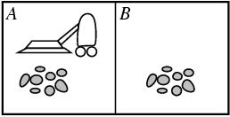
Intelligent Agents
Example: Automated Vacuum Cleaner
Environment: Square A and B, dirt etc.
Sensors: Camera, Optical Encoders, Wall Sensors etc.
Actuators: Wheels, LED Lights, Dirt Picker etc.
Goal: Keep rooms clean

Slide 5
Intelligent Agents
Structure of Intelligent Agents
Agent architecture is the combination of agent program and agent architecture. Agent program is the program that implements agent function.
Agent function is the mathematical function that describes behavior of agent. It maps any given percept sequence to an action. Percept to refer to the agent's perceptual inputs at any given instant and percept sequence is the complete history of everything the agent has ever perceived.
Agent program runs on some sort of computing device with sensors and actuators called agent architecture.

Slide 6
Intelligent Agents
Structure of Intelligent Agents
Agent
Sensors
Actuators
E
N
V
I
R
O
N
M
E
N
T
Percepts
Agent Program
Actions

Slide 7
Rational Agent
A rational agent is one that does the right thing. Right action is the one that will cause the agent to be most successful.
Therefore we need some way to measure success of an agent. Performance measures are the criterion for success of an agent behavior. For the Vacuum cleaner world performance measure may be
The amount of dirt cleaned within a certain time or
How clean the floor is.
It is better to design Performance measure according to what is wanted in the environment instead of how the agents should behave. It is not easy task to choose the performance measure of an agent.

Slide 8
Intelligent Agents
Properties of Intelligent Agents
In AI, intelligent agents refer to software agents with some sort of intelligence. These Software agents must exhibit following characteristics.
Intelligent
Autonomy
Ability to Learn
Cooperation
Reactive and Proactive

Slide 9
Intelligent Agents
Properties of Intelligent Agents
Intelligence
Intelligent agents must have domain knowledge that enables them to carry out their tasks even when the parameters of the task are changed or when unexpected situations arise. For example, an intelligent agent might be designed to buy books for a user on the Internet at the lowest possible price. The agent would need to be able to interact with a set of online bookstores but would also need to be able to learn how to deal with new bookstores.

Slide 10
Intelligent Agents
Properties of Intelligent Agents
Autonomy
In addition to intelligence, an important feature of many intelligent agents is autonomy—the ability to act and make decisions independently of the programmer or user of the agent. For example, an intelligent buying agent that is designed to buy goods on behalf of a user needs to be able to make decisions about what items to purchase without checking back with the user.

Slide 11
Intelligent Agents
Properties of Intelligent Agents
Ability to Learn
Intelligent agents must have an ability to learn. For example, agents can learn from a user by observing actions or by being given instruction. Agents can also learn from other agents in multiagent systems. Learning allows agents to improve their performance at carrying out a particular task over time.

Slide 12
Intelligent Agents
Properties of Intelligent Agents
Cooperation
In multiagent systems, agents usually cooperate with each other. For example, a buying agent may negotiate with selling agents to make purchases. A buying agent may be informed by another buying agent about a new shopping portal that the agent may find useful.

Slide 13
Intelligent Agents
Properties of Intelligent Agents
Reactive and Proactive
Another characteristic of an agent is the degree of proactivity and reactivity in their behavior. An agent is said to be reactive it responds in timely fashion to changes in environment and is said to be proactive if it responds in the best possible way to future possible actions that are anticipated to happen.

Slide 14
Configuration of Agents
Agent configuration is the process of configuring percepts, actions and agent functions for intelligent agent.
Example: Internet shopping agents
Percepts: Web Pages, User Requests
Actions: Follow Links, Extract Book Data, Display to User
Agent Function: Description of agent function for internet shopping agent is given below.
Percept | Action
User Request | Search
Book Found | Extract Book Data
Link Found | Follow Link
……… | ………..

Slide 15
PEAS Description
A rational agent always performs right action, where the right action means the action that causes the agent to be most successful in the given percept sequence. The problem the agent solves is characterized task environment.
Task environment is PEAS description of the environment, where PEAS stands for Performance, Environment, Actuators, and Sensors

Slide 16
PEAS Description
PEAS description for Automated Taxi Driver:
Performance: Safety, destination, profits, legality, comfort
Environment: Streets/freeways, other traffic, weather etc.
Actuators: Steering, accelerator, brake, horn, speaker/display etc
Sensors: Camera, speedometer, engine sensors, keyboard, GPS etc.

Slide 17
PEAS Description
PEAS description for Medical Diagnosis System:
Performance: Healthy Customers, minimize costs, lawsuits etc.
Environment: Patients, Hospitals, Staffs etc.
Actuators: Screen display (diagnoses, questions, tests, treatments, referrals), printer etc.
Sensors: keyboard (Symptoms, Findings, Patient Answers), Scanner etc.
Note:- PAGE-Performance, Action, Goal, Environment

Slide 18
Types of Agent
Simple Reflex Agent
Agent
Sensors
What the world is like now
Environment
Condition-action rules
What action I should do now
Effectors

Slide 19
Types of Agent
Simple Reflex Agent
It is also called table lookup agent. These agents take decisions on the basis of the current percepts and ignore the rest of the percept history.
These agents only succeed in the fully observable environment.
The Simple reflex agent does not consider any part of percepts history during their decision and action process.
The Simple reflex agent works on Condition-action rule, which means it maps the current state to action. Such as a Automated Vacuum Cleaner, it works only if there is dirt in the room.

Slide 20
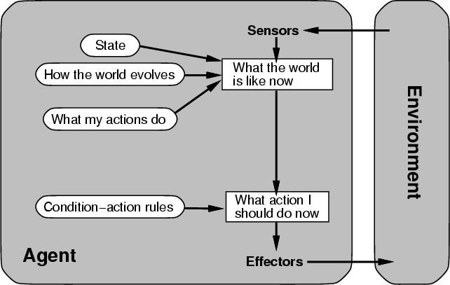
Types of Agent
Model Based Agent

Slide 21
Types of Agent
Model Based Agent
The Model-based agent can work in a partially observable environment, and track the situation.
These agents have the model, "which is knowledge of the world" and based on the model they perform actions.
A model-based agent also has Internal State: It is a representation of the current state based on percept history.
Updating the agent state requires information about:
How the world evolves
How the agent's action affects the world.
Example: Medical Diagnosis System

Slide 22
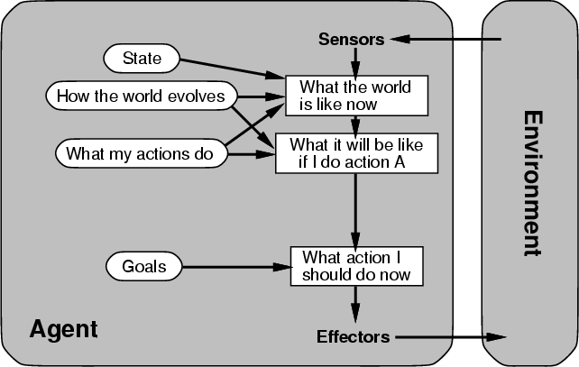
Types of Agent
Goal Based Agent

Slide 23
Types of Agent
Goal Based Agent
These agent needs to know its goal which describes desirable situations.
Goal-based agents expand the capabilities of the model-based agent by having the "goal" information.
They choose an action, so that they can achieve the goal.
These agents may have to consider a long sequence of possible actions before deciding whether the goal is achieved or not. Such considerations of different scenario are called searching and planning, which makes an agent proactive.
Example: Automated Taxi Driving System

Slide 24
Types of Agent
Utility Based Agent
These agents are similar to the goal-based agent but provide an extra component of utility measurement which makes them different by providing a measure of success at a given state.
Utility-based agent act based not only goals but also the best way to achieve the goal. The Utility-based agent is useful when there are multiple possible alternatives, and an agent has to choose in order to perform the best action.
The utility function maps each state to a real number to check how efficiently each action achieves the goals.
Example: Chess Playing Agent

Slide 25
Types of Agent
Learning Agents
A learning agent in AI is the type of agent which can learn from its past experiences, or it has learning capabilities.
It starts to act with basic knowledge and then able to act and adapt automatically through learning.
Hence, learning agents are able to learn, analyze performance, and look for new ways to improve the performance.

Slide 26
Types of Agent
Examples
Which type of agent is appropriate for following agents? Give proper justification.
Robotic Vacuum Cleaner
Disease Diagnoser
Automated Taxi Driver
Searching Robot
Route Recommender

Slide 27
Environment Types
Fully observable vs. Partially observable
If it is possible to determine the complete state of the environment at each time point from the percepts it is observable; otherwise it is only partially observable.
Fully observable environments are convenient since agents are free from keeping track of changes in environment.
Examples: Environment of chess playing is fully observable whereas environment of automated taxi driving system is only partially observable.

Slide 28
Environment Types
Deterministic vs. Stochastic
If the next state of the environment is completely determined by the current state and the actions of the agent, then the environment is deterministic; otherwise it is non-deterministic.
In a Stochastic environment there are multiple unpredictable outcomes.
Examples: Robot on Mars Stochastic environment whereas Tic- Tac-Toe game is Deterministic environment

Slide 29
Environment Types
Episodic vs. Sequential
In an episodic environment subsequent episodes do not depend on actions occurred in previous episodes whereas in sequential environments episodes are connected with previous episodes.
Choice of action in each episode depends only on the episode itself . Episodic environments are much simpler because the agent does not need to think ahead.
Examples: Environment of Expert Advice system is episodic whereas environment of chess playing system is Sequential.

Slide 30
Environment Types
Static vs. Dynamic
If the environment does not change while an agent is acting, then it is static; otherwise it is dynamic. Other agents in an environment makes it dynamic. The goal might also change over time.
Environment is not dynamic if the agent moves from one part of an environment to another.
Examples: Environment of football playing is dynamic whereas environment of expert systems is static.

Slide 31
Environment Types
Discrete vs. Continuous
If there are a limited number of distinct, clearly defined, states of the environment, the environment is discrete otherwise it is continuous.
Examples: Environment of tic-tac-toe game is discrete whereas environment of automated taxi driving systems is Continuous.

Slide 32
Environment Types
Single agent vs. Multi-agent
An agent operating by itself in an environment is single agent environment. If other agents are also present in environment, it is called multi-agent environment.
In multi-agent environments, agents can be competitive or cooperative.
Examples: Environment of expert systems is single agent whereas environment of chess playing system, automated driving systems is multi-agent.

